Slide 1
Workday
20%
20%
40%
Get a 20% reduction in total program implementation cost due to early Promantus advisory involvement
Get a 20% reduction in time-to-market from decision to going live
Get a 40% savings in AMS
Test
Advisory
Integration
Test
Acceptance
Add on Proj
Def. Need
& Budget
RFP
Vendor
selection
Imple-ment
Test
Deploy
AMS
COMPANY
PROMANTUS
WORKDAY PARTNER
Timeline
In total get a
25-30% reduction in program costs
as well as a higher end-to-end quality

Slide 2
The Traditional Challenges
Customer
Change to a new HR system is a business driven strategic decision often taken with limited IT involvement
Adaptation and post implementation application maintenance for new HR solutions are always stressing the users
The Workday Solution regions/verticals go-live strategy is a organizational challenge
Workday implementation is monopolized with limited competition
There are very few Workday experts available outside the monopolized delivery system
Partner
Frequent changes in requirements leads to
Uncertainty
Change in Go-Live dates
Reduced quality in Go-Live planning
Reduced access to the right resources
Consequences
Unclear requirements
Business/IT conflicts
Many temporary integrations
Implementation cost overrun
Implementation time overrun
Transition issues
AMS undefined

Slide 3
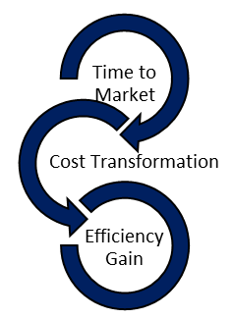
The Workday Process
DECISION PROCESS
The client organization concludes that current HR solution(s) are unable to meet future requirements. Workday is seen as a serious alternative
Scanning the HRS market Workday is identified as the preferred future solution, and processes to prepare a requirements specification (and rarely an RFP process) are initiated
Workday provides a “Tenant’s GMS access”, which is a demo version
CONTRACTS PROCESS
DEVELOPMENT PROCESS
Discovery sessions for requirement gathering
Resourcing, planning and architecture
Implementation and conversion of legacy data
Testing
Go-Live and hypercare
AMS PROCESS
Promantus Benefits
Time to Market
We help clients to define needs, create budget, prepare RFP, and to select the Workday Partner for implementation
We help clients developing integrations and to test the implementation
We do Workday AMS and develop add-on projects
Leading to a more efficient end-to-end process
Cost
The Promantus interaction leads to a 25-30% reduction in total program costs
Quality
Promantus’ support leads to increased user satisfaction due to enhanced business user participation and due to the live documentation of features and user stories available.

Slide 4
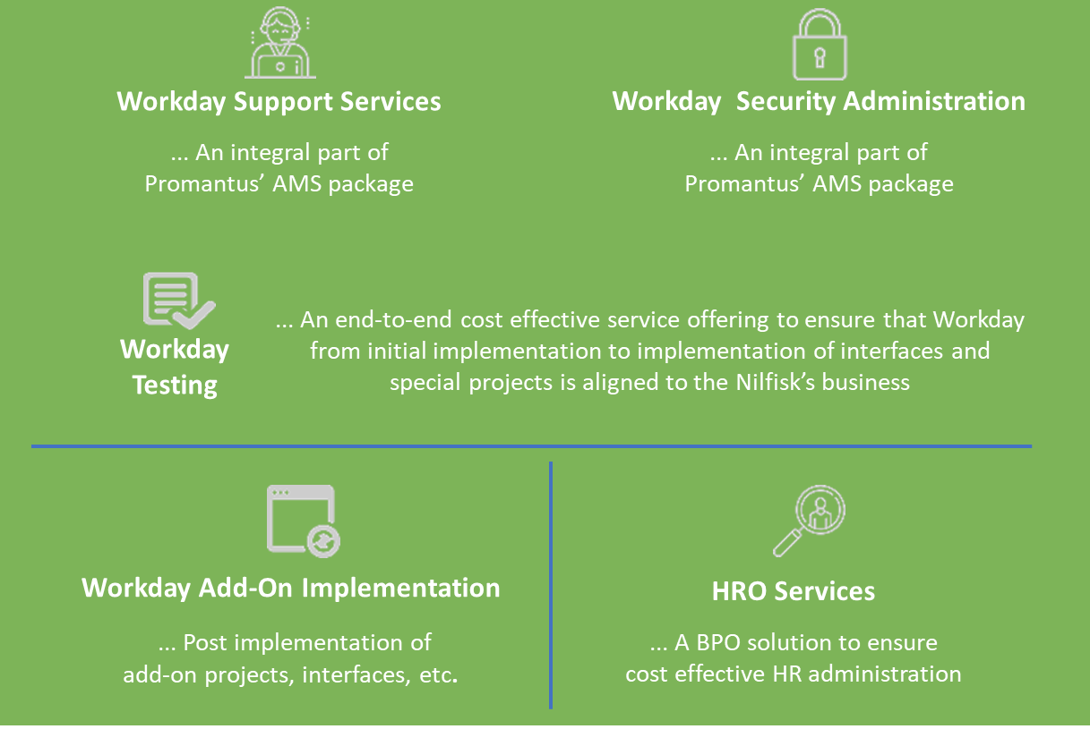
© Promantus Inc.
Raleigh, NC, USA
www.promantusinc.com
Promantus’ Value Propositions
Promantus help clients to identify and document requirements
Bridge the gap between business and technology by defining acceptance criteria using shared business terminology.
Promantus can manage communication between client and the Workday partner
We collaborate during Discovery, Implementaion, Testing, Go-Live & Hypercare
Promantus can help clients to develop and manage integrations
Participating in the process Promantus can help to identify known issues during implementation & manage during transition
Promantus help clients to prepare and do acceptance tests
As advisors Promantus can ensure that implementers and testers use right test cases during UAT
Promantus is offering to maintain the Workday environment (AMS)
Participating during implementation and Testing, the transition will be smooth and effective. AMS without issues.

Slide 5
OPPORTUNITY ASSESSMENT
CLIENT:
OPPORTUNITY:
BUSINESS DEVELOPER
PARAMETERS |  |  |  | COMMENTS
HAS THE CLIENT A DEFINED NEED? Are the needs properly defined Does the client have a compelling event Does the client have a budget |  | 5 5 4 | 4.7 | An outside-in perspective. (Weight 30%)
CAN WE WIN? Do we have the right services offerings Are we competitive |  | 4 4 3 | 3.7 | An inside-out perspective (Weight 20%)
IS IT WORTH WINNING? Do we have the resources Is it profitable Does a win have a long term perspective |  | 3 3 4 | 3.3 | An inside-out perspective (Weight 20%)
WILL WE BE ALLOWED TO WIN? How is our relation with decision takers How is our relation with influencers Has the client a favourable vendor strategy |  | 4 3 5 | 4.0 | An outside-in perspective (Weight 30%)
OVERALL SCORE Rate each parameter (0=very weak, 5=leading) Assign weight (importance to each paramer) |  | 4.0 |  | The weighted perspective If score ≥4.0 = consider go If score ≤3.5 = consider no-go
CONCLUSION

